Slide 1
Implementing Entity Framework with MVC Jump Start
Christopher Harrison | Content Developer, Microsoft
Adam Tuliper | Technical Evangelist, Microsoft

Slide 2

Meet Adam Tuliper | ‏@AdamTuliper
Technical Evangelist, Microsoft
Focused on Web, Data, Gaming, and Cloud Technologies
Emphasis on secure development practices
20 years of industry experience as software architect
Enterprise, startups, public sector, defense, healthcare, financial industries
channel9.msdn.com/Blogs/AdamTuliper
Video content
adamtuliper.com

Slide 3
Course Topics
Implementing Entity Framework with MVC
01 | Introduction to Entity Framework | 04 | Managing the database
02 | Beginning Code First | 05 | Managing transactions
03 | Managing Relationships | 06 | Integrating extra features and looking forward

Slide 4
01 | Introduction to Entity Framework
Christopher Harrison | Content Developer, Microsoft
Adam Tuliper | Technical Evangelist, Microsoft

Slide 5
Module Overview
Architecture
Intro to Code First
Generating EF Classes

Slide 6
Architecture

Slide 7
What is EntityFramework
It IS an ORM
What’s an ORM?
Maps your database types to your code types
Avoids repetitive data access code
Customer
CustomerInfo.cs
Customer
Customer.cs
ShipTo

Slide 8




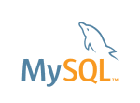





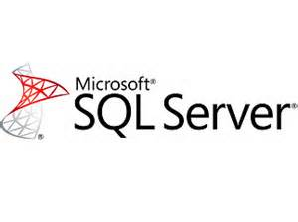



EF Platforms
EF 6.1 Any project that is full .NET 4+
Excluding Windows Phone / Store (see EF7)
Web Forms, MVC, WPF, WCF, Web API, Web Forms
Azure Table Storage, Redis, Mono Mac Linux (EF7)
Notes:
Talk about nuget packages, upgrading, rolling back, etc.
IBM supplies ADO.NET data providers for access to DB2, Informix, and U2 databases.
Any ADO.NET Data Provider?

Slide 9
Some supported features
Full ORM to map objects to code
Async Queries
Connection Resiliency (retry)
Stored Procedure mapping
Reverse engineering existing database
Using code to create database (code first)
Concurrency detection
Enum & Spatial Data support

Slide 10
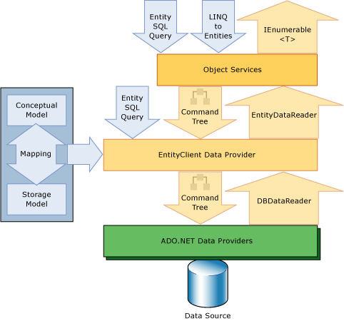
High level view
LINQ to Entities
Convert to query, execute
Map results to entities

Slide 11
Installing Entity Framework
EF6 Requires Visual Studio 2010 or greater
NuGet
Install-package EntityFramework
Comes as part of
MVC, Web Forms, Web API templates if Identity is used

Slide 12
NuGet Primer
Install-Package EntityFramework
Latest non-beta
Install-Package EntityFramework –pre
pre release version
Uninstall-Package EntityFramework
Update-Package EntityFramework –reinstall (all projects)
Update-Package EntityFramework -ProjectName MyProject
Notes:
Update-Package -Reinstall (reinstall all packages in all projects)

Slide 13
Installing and Managing Entity Framework Binaries
Notes:
Create MVC app without identity, Install-package entityframework
Create MVC app with identity, show it already exists. Show how to upgrade, remove, reinstall.
Update-Package EntityFramework (maybe –pre if theres time)

Slide 14
Intro to Code First

Slide 15
Code First
The term ‘code first’ – a misnomer?
Allows you to use POCO classes as entities
Uses at a minimum a DbContext and an entity (ie a class)
public class Album
{
public string Name { get; set; }
public decimal Cost{ get; set; }
}
public class MusicStoreDbContext : DbContext
{
public DbSet<Album> Albums{ get; set; }
}

Slide 16
Basic code first and scaffolding
Notes:
Create a new console app
Install-package EF
Add class
public class Album
{
public int AlbumId { get; set; }
public int GenreId { get; set; }
public int ArtistId { get; set; }
public string Title { get; set; }
public decimal Price { get; set; }
public string AlbumArtUrl { get; set; }
}
public class MusicContext : DbContext
{
public DbSet<Album> Albums { get; set; }
}
4. Run the app. Explain the database is created because of connection string in the name in DbContext
5. If DbContext doesn’t have a connect string, we look for the name of the context class connection string.
If that’s not found, we try to create SQLExpress, local db 12, local db 11

Slide 17
How does EF connect to your db?
Could be cloud, App_Data folder, Intranet, Internet, other folder
Connect string named in DbContext class
Read connect string
Open Connection
You should always specify a connection string name when you intend to use a connection string in the config file. This ensures that if the connection string is not present then Entity Framework will throw rather than creating a new database by convention.
public MusicContext() : base("MusicStoreConnection")
{
}
Use context class name to look for connect string in web.config
Read connect string
Open Connection
No connect string.
Start database checks
Look for SQL Express
Look for (localdb)\\11
Look for (localdb)\\mssqllocaldb
Notes:
SHOW HOW TO STORE CREDENTIALS as a best practice?
DB name will be that of the connection string name, ie
Data Source=(localdb)\mssqllocaldb;Initial Catalog=MusicStoreConnection;Integrated Security=True
public MusicContext()
: base("MusicStoreConnection")
{
}

Slide 18
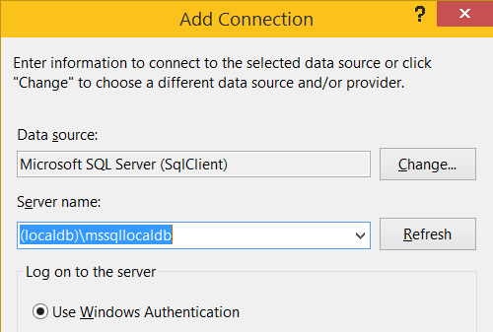
Helpful Hint
Note differences in localdb connection string
Connection string
Data Source=(localdb)\\mssqllocaldb;
In dialog to connect
(localdb)\mssqllocaldb
Notes:
Connection string can be double slash
"Data Source=(localdb)\\mssqllocaldb;Initial Catalog=MusicStoreConnection;Integrated Security=True;MultipleActiveResultSets=True“

Slide 19
Database Initializers
Notes:
Demo how to see connection info (wheres our connect string coming from?!)
context.Database.Log = s => Console.WriteLine(s);
Console.WriteLine(context.Database.Connection.ConnectionString);
Sql server object explorer
(localdb)\MSSQLLocalDB (used as of v12 ie sql 2014)
(localdb)\\v11.0
What versions are on my machine?
C:\Users\adam> sqllocaldb v
Microsoft SQL Server 2012 (11.0.3000.0)
Microsoft SQL Server 2014 (12.0.2000.8)
Lets create a connection string for a local folder.
Viewing SQL (one way) via sql connection manager and db project. Maybe show this in migrations?
Database.SetInitializer<MusicStoreContext>(new CreateDatabaseIfNotExists<MusicStoreContext>());
<appSettings>
<add key="DatabaseInitializerForType SchoolDataLayer.SchoolDBContext, SchoolDataLayer"
value="System.Data.Entity.DropCreateDatabaseAlways`1[[SchoolDataLayer.SchoolDBContext, SchoolDataLayer]], EntityFramework" />
</appSettings>

Slide 20
Viewing queries and connection info
Notes:
//View queries
context.Database.Log = s => Console.WriteLine(s);
//Log connection
Console.WriteLine(context.Database.Connection.ConnectionString);
Using glimpse
Install-package glimpse.mvc5
install-package glimpse.entityframework
Inside the <entityFramework> element
<interceptors>
<interceptor type="System.Data.Entity.Infrastructure.Interception.DatabaseLogger, EntityFramework">
<parameters>
<parameter value=“MyAppsOutput.txt"/>
<parameter value="true" type="System.Boolean"/>
</parameters>
</interceptor>
</interceptors>

Slide 21
Generating EF classes

Slide 22
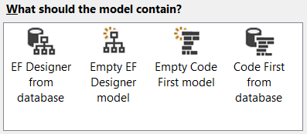
Ways to generate
Hand coding classes
Use a visual designer
Add->ADO.NET Entity Data Model
Database First Entity Designer

Slide 23
Generating database and reverse engineering
Notes:
Look briefly at dialog
Choose an existing database with music store information in it and reverse engineer it. Will revisit on fluent api?

Slide 24
Resources
http://blogs.msdn.com/b/adonet/
Add this to the last session
http://romiller.com/2014/06/10/reducing-code-first-database-chatter/

